Slide 1
November 2026 Alma and Primo Quarterly Release Notes Webinar
October 29, 2026
Notes:
[Speaker: Bradley]

Slide 2
Today’s Agenda​
Announcements, Events, and Reminders​
November 2026 Quarterly Release Features​
  Alma features​
  Primo VE features​
Q&A​
Today’s session is being recorded and will be posted to the CARLI website. ​
Notes:
[Speaker: Bradley]

Slide 3
Announcements and Events
Upcoming Events – see also the CARLI Calendar
  Sunday, Nov. 1, 2026 – Alma and Primo Quarterly Feature Release
CARLI Annual Meeting Nov. 10 (Register for in-person or online)
Limited availability of CARLI Staff during Annual Meeting and Staff Retreat, Nov. 10-11
CARLI offices are closed for Thanksgiving and Holiday Break
ELUNA Learns opportunities available through January 2027
“Linking Parser Parameters: A Review” sessions November 16, 17, 20 (registration is required)
Notes:
[Speaker: Bradley]
This slide has some announcements and upcoming events. See the CARLI Calendar for a full list of upcoming events!
Most importantly, the November Feature Release we will be discussing today will be available in production on Sunday, November 1

Slide 4
Reminders
In this webinar, CARLI Staff are sharing the updates we feel are most important to the I-Share environment.
Staff at I-Share libraries can review the full set of release notes available from the Alma and Primo Support Pages:
  Alma Release Notes
  Primo Release Notes
Slides have been marked with audience tags:
Acquisitions
Analytics/Statistics
Cataloging
Circulation
Configuration
ILL/ Resource Sharing
Everyone
Electronic Resources Management
Primo / Discovery
Reference/ Instruction
Systems
User Management
Notes:
[Speaker: Bradley]
In today’s presentation, we are highlighting those updates in Alma and Primo VE that are the most important to the I-Share environment. In the interest of time, we’re not covering everything, so we encourage you to review the release notes yourself. You may find something that is practical to your local uses, though you will also encounter some updates that don’t apply to I-Share libraries at all. If you have any questions about updates, please contact us at support@carli.illinois.edu.
Slides have been marked with audience tags to help you get information to the right people at your institution.
These slides are available for download on the CARLI website.

Slide 5
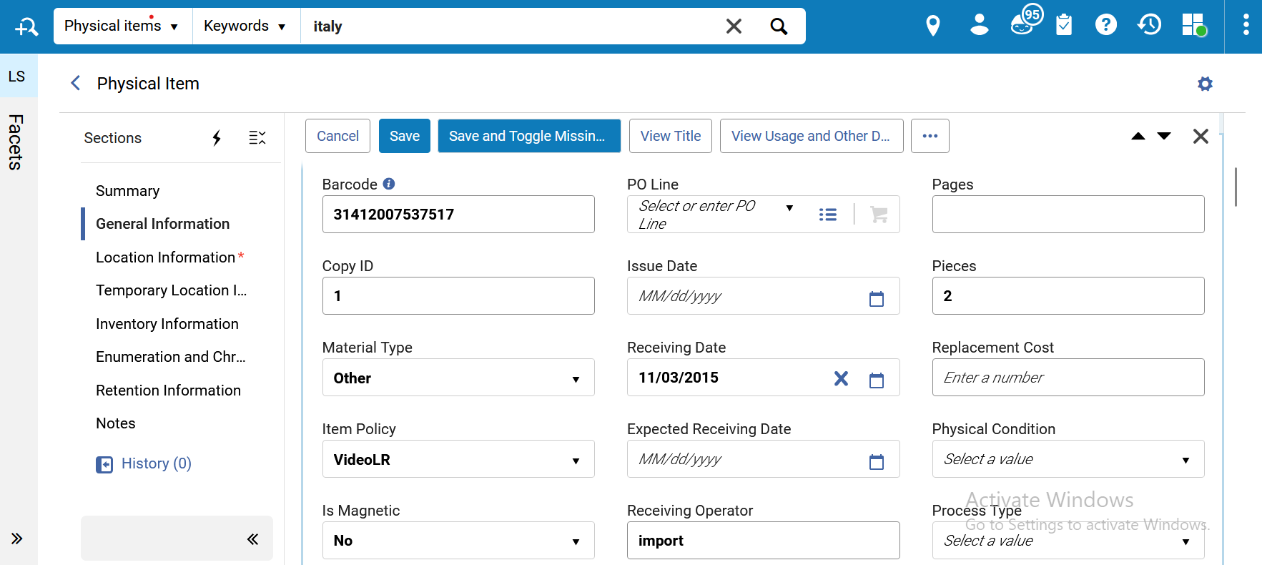
New Physical Items Search
The New Physical Items Search is on by default
To turn off the New Physical Items Search, go to Feature Rollout Preferences and change the toggle switch
Some upgrades to placeholders in text fields, enumeration and chronology, and editing
A screenshot of an item in the New Physical Items Search
Everyone
Notes:
[Speaker: Adrienne]
[Audience Tags: Everyone]
The generic Enter a value placeholders in text fields were removed to provide a cleaner, more accessible editor. The text fields now show placeholders only where they deliver meaningful information to the user (e.g. "Enter a number" indicating that a field must contain a numeric value). This makes it easier to scan the editor and identify empty fields.
The Enumeration and Chronology Information section was improved to help serials operators enter information. The improvements include:
This section is now a more static section, with paired enumeration and chronology fields displayed at a maximum of 2 columns, to make it easier to identify and fill in related enumeration and chronology information (Enumeration A - Chronology I, Enumeration B - Chronology J, etc.). This pairing means that in wide screens, where more than a single column is displayed, the enum/chron fields are organized side-by-side (rows), and not from the top downwards (columns) as the rest of the sections.
A separating line is displayed under each pair, to further assist in filling in the form.
The Description field is placed after the most common enum/chron fields (Enumeration A-B, Chronology I-J), to streamline the generation of a description based on these fields. The description field is separated from the enum/chron fields above and below it using a separating line, to make it easy to distinguish and fill in - in wide screens, where more than a single column is displayed, it will appear as a single column (with no other fields in that row).
Streamlined editing: selecting the Edit button now focuses on the first editable field of the item upon opening the editor - out-of-the-box, this is the Barcode field in the General Information section. If the editor was customized to place another editor section first, the focus will be placed on the first editable field of that section. This streamlines item editing and offers better support for workflows such as Barcode entry.

Slide 6
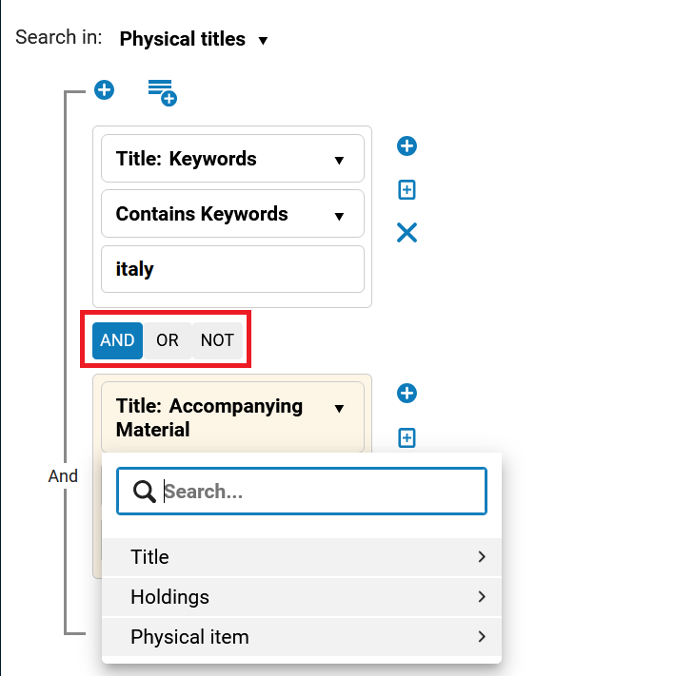
Boolean Operators in the Advanced Search
The toggle for Boolean operators now appear below the selection for the search.
A ‘Not’ operator was added
A screenshot showing the Boolean operators in the Advanced Search
Everyone
Notes:
[Speaker: Adrienne]
[Audience Tags: Everyone]
The advanced search uses hierarchical entity levels. For example, a Physical Title can have multiple Holdings, and a Holding can have multiple Items. Because of this structure, using the Boolean ‘NOT’ may return results that seem counter-intuitive when your search entity level and index level differ.

Slide 7
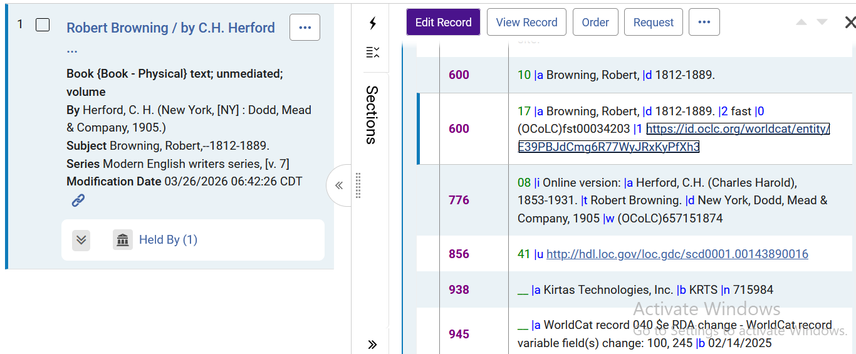
Clickable URIs in the Bibliographic Record Section of a Title
In the All Titles search, Bibliographic Record section, URIs appear as a clickable link.
When you click the link, it opens a new tab in the browser
Note that the View Record view does not have these links
Clickable URIs in the Bibliographic Record section of a title
Everyone
Cataloging
Notes:
[Speaker: Adrienne]
[Audience Tags: Everyone, Cataloging]

Slide 8
More User Interface Enhancements
When one or more sets are selected, the Bulk Action buttons are enabled. New in this release is Manage Labels, in which you can add or delete labels.
An Expand or Collapse All button was added above the sections in the Details pane.
When users resize a sliding panel, the new size is automatically applied the next time the user opens a sliding panel. The saved preference is kept across sessions.
Wide tables can now be viewed using horizontal scrolling, making all columns accessible without resizing them to fit the available screen width. Key columns remain visible during scrolling.
Everyone
Notes:
[Speaker: Adrienne]
[Audience Tags: Everyone]

Slide 9
Metadata, AI, and Transparency
In July 2026, the European Union adopted the EU AI Act
  Requires transparency on use of, and interactions with, AI
  Visual indications and icons for humans, machine data for machines
  “Enhancing Transparency for AI-Generated Content”
Transparency and data provenance AI Metadata Assistant
  LLM upgraded to GPT-5 with reasoning.
  Contents and summaries transcribed or generated get $7 note on AI use.
  AI Metadata Assistant outputs are suggestions, not autosaved to record.
Alma AI tools may be opted in/out at institution level
  Configuration > General > AI Features > AI Features Management
Everyone
Cataloging
Notes:
[Speaker: Ted]
[Audience Tags: Everyone, Cataloging]
In July 2026, the European Union adopted the European Union Artificial Intelligence Act. This puts in place regulations that require information providers and software deployers to identify when users will be interacting with AI-generated content or experiences. Requirements include providing icons and language that identify AI-generated content, for instance the sparkles icon that appears in Alma already. Also required is the provision of machine-readable data, such as digital watermarks, that allows AI-generated content to be detected by other algorithms. Clarivate has shared a statement in the documentation on Enhancing Transparency for AI-Generated Content that identifies their broader goals, though not specifics on how or where these indications will appear.
The AI Metadata Assistant has been present in Alma for a couple years already as one of the earlier instances of including generative AI in Alma. In this release, they are updating the large language model for the tool to GPT-5 with reasoning. The output of suggestions, which may take longer than before, will now include statements such as “transcribed by AI” or “generated by AI” in the provenance subfield of the 505 contents note and the 520 summary note. For catalogers, one may check for the 505 subfield 7 and 520 subfield 7. The release notes and documentation do not specify whether other fields or subfields will receive this information.
Note that the AI metadata assistant’s outputs are suggestions added to draft version of a record, and they are not automatically saved. Human catalogers should decide whether to accept recommendations or to modify or identify those recommendations further.
Alma’s AI tools may be used or avoided by an institution in Alma configuration. An AI Features Management option appears on the general configuration menu as well as other menus, such as acquisitions, resources, and fulfillment.

Slide 10
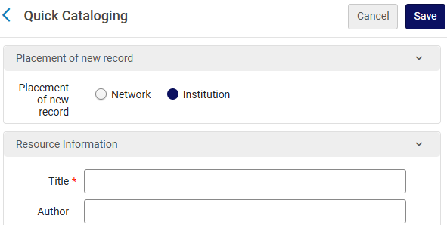
Set Default Zone for Quick Cataloging
New configuration screen and parameter
  Set default zone for quick cataloging records
  “Central Record Management”
Applies to Create Inventory >
  Add Local Portfolio
  Add Physical Item
Applies to Reading List >
  Add Citation > Add Brief
The quick cataloging screen for a new physical item.
Cataloging
Notes:
[Speaker: Ted]
[Audience Tags: Cataloging]
If any staff at your library uses the quick cataloging options of Alma, you may find this useful. A new setting is available to set the institution zone as the default for records created on the quick cataloging screen. The setting is found on a new screen, Central Record Management, found on the Resources Configuration menu. Setting Default Institution should be the preferred setting for quick cataloging of new brief records, and as seen here, changes the default placement of the record from Network to Institution.

Slide 11
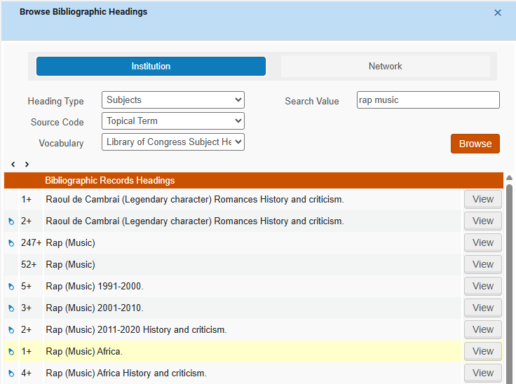
Partially Linked Headings
Spyglass icon (above) appears for partially-linked headings in bib records
Also appears in browse headings results
  Find in column to left of heading count and heading
The browse bibliographic headings screen.
Cataloging
Notes:
[Speaker: Ted]
[Audience Tags: Cataloging]
Catalogers that browse for headings found in bibliographic records will now see the spyglass icon next to headings that are partially linked.
In bib records, the partial link icon typically appears when the bib record heading links to an authority heading that may be subdivided, for instance with standard subdivisions or geographic subdivisions, but where there isn’t a formally established authority record for the full heading found in the record. The enhancement now ensures that the same icons appear in browse results, instead of using the binoculars icon that identifies a fully linked heading.

Slide 12
Renew I-Share Loan from Network Activities Tab
Library staff are again able to renew an I-Share loan on behalf of a patron through Alma.
The “Renew” action for loans is listed on the Network Activity Tab.
The renewals follow the regular “eligible for renewal” conditions at the item’s home library.
Automatic Renewals are enabled for I-Share loans.
For more information: “Alma- Automatic Renewals for Local and I-Share Patrons”
https://www.carli.illinois.edu/products-services/i-share/alma-config/alma-auto-renew
Circulation
ILL/ Resource Sharing
Reference/ Instruction
Notes:
[Speaker: Debbie]
[Audience Tags: Circulation, ILL/Resource Sharing, Reference/Instruction]
With the November release, Ex Libris has re-introduced the ability for staff to renew an I-Share loan on behalf of a patron through Alma.
I have screenshot on the next slide showing that in the patron’s fulfillment activity, on the Network Activity Tab, there is now a “Renew” action listed under the row action ellipsis for the loan.
That renewal option does follow the regular “eligible for renewal” conditions at the item’s home library.
"Eligible for renewal" means:
The user record has an active patron role.
The user record expiration date is far enough in the future.
The user record is "active."
The user does not have blocks or exceeded limits.
There is a permissive auto-renewal rule that applies to the transaction.
The item is renewable.
The item has a status that allows renewals.
The auto-renewal calculated due date would be a date different than the current due date.
The transaction has not yet reached the end of the "maximum renewal period" in the governing terms of use.
The item does not have a pending booking request that will conflict with the renewal.
There are no "general errors" (from ExL documentation).
Auto-renewals are enabled for loans to I-Share patrons, so this option is here, but may not be as needed as it used to be.

Slide 13
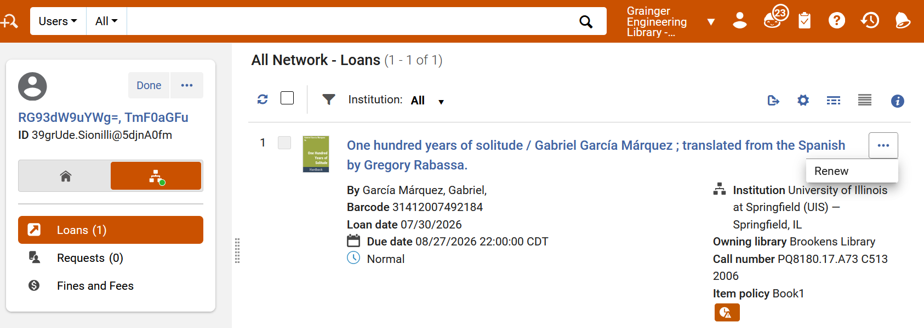
Renew I-Share Loan from Network Activities Tab (continued)
On the Network Activity tab, the new option to “Renew” a home patron’s I-Share loans is displayed.
Circulation
ILL/ Resource Sharing
Reference/ Instruction
Notes:
[Speaker: Debbie]
[Audience Tags: Circulation, ILL/Resource Sharing, Reference/Instruction]
Here’s an example of the Renew option now showing for a patron’s I-Share loan on the Network Activity tab.
Depending on your display customization settings, you may see a Renew button for the loan, or, it might be nested under the row action ellipsis.

Slide 14
NOPE: “Keep My Loan History” Setting
Ex Libris added a new “Keep My Loan History” option to the user record general information tab.
DO NOT check this box for any user record. If checked by library staff, the patron’s loans would not be anonymized during the loan anonymization process.
Reminder: Anonymization of User Fulfillment Data in Alma is mandatory.
“CARLI enabled Alma’s anonymization of user data feature for all I-Share libraries on July 29, 2024. This implemented the anonymization of most user data in Alma after a retention period of seven days after a transaction ends, except for fine/fee data, which will be retained for seven years. These settings permit CARLI and I-Share libraries to fully comply with national and state privacy laws and local privacy policies. This action and the corresponding consortial Alma configurations were approved by the CARLI Governance Board on March 8, 2024.”
https://www.carli.illinois.edu/products-services/i-share/alma-fulfillment/anonymization
Everyone
Circulation
Reference/ Instruction
User Management
ILL/ Resource Sharing
Notes:
[Speaker: Debbie]
[Audience Tags: Everyone, Circulation, Reference/Instruction, User Management, ILL/Resource Sharing]
Ex Libris added a new “Keep My Loan History” option to the user record general information tab. I have a screenshot on the next slide to show you.
If checked by library staff, the patron’s loans would not be anonymized during the loan anonymization process.
Reminder: Anonymization in Alma is mandatory.
To read a little bit about our choice to anonymize data in Alma, as written on our “Alma Anonymization of User Fulfillment Data” webpage:
“CARLI enabled Alma’s anonymization of user data feature for all I-Share libraries on July 29, 2024. This implemented the anonymization of most user data in Alma after a retention period of seven days after a transaction ends, except for fine/fee data, which will be retained for seven years. These settings permit CARLI and I-Share libraries to fully comply with national and state privacy laws and local privacy policies. This action and the corresponding consortial Alma configurations were approved by the CARLI Governance Board on March 8, 2024.”

Slide 15
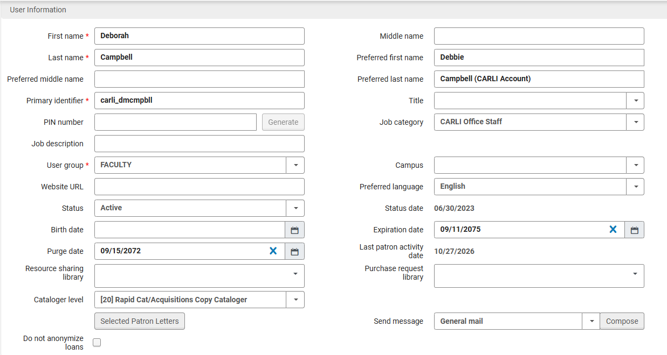
NOPE: “Keep My Loan History” Setting (continued)
The new “Do not anonymize loans” checkbox in the user information section of the user record’s “General” tab is displayed.
Everyone
Circulation
Reference/ Instruction
User Management
ILL/ Resource Sharing
Notes:
[Speaker: Debbie]
[Audience Tags: Circulation, Reference/Instruction, User Management, ILL/Resource Sharing]
This screenshot shows you the “Do not anonymize loans” checkbox that now displays in each user record, in the staff view in Alma.
Inform all library staff that they SHOULD NOT check this checkbox.

Slide 16
NOPE: Requesting on Behalf of Patrons
Across Institutions
The release notes mention there is now the ability for library staff to place a resource sharing request in Alma for an I-Share item for another I-Share library’s patron.
DO NOT do this.
Why not?:
  I-Share patrons should place requests for I-Share items using their home library user records.
  These requests look atypical and may confuse patrons and library staff.
  Since the sandboxes do not have Analytics, we cannot confirm how I-Share statistics would be affected.
Note: This is different than the request workflow steps for filling an I-Share patron’s request for a multivolume set of your library’s materials.
https://www.carli.illinois.edu/products-services/i-share/alma/fulfillment/how-to_AFN
Everyone
Circulation
ILL/ Resource Sharing
Reference/ Instruction
Notes:
[Speaker: Debbie]
[Audience Tags: Circulation, ILL/Resource Sharing, Reference/Instruction]
If you read in the release notes that library staff can now place a resource sharing request in Alma for an I-Share item, for another I-Share library’s patron, DO NOT do this.
I-Share patrons should place requests for I-Share items using their home library user records.
From testing this workflow in the sandboxes, these requests look atypical, and therefore confusing to both staff and library patrons.
Since the sandboxes do not have Analytics, we cannot yet confirm how this workflow would affect our I-Share statistics.
So again, please do not place an Alma Resource Sharing request for another I-Share library’s patron. The patron should either place the request themselves through Primo VE, or, contact their home library for staff assistance.
Note: This is different than the steps we have outlined for filling an I-Share patron’s request for a multivolume set of your library’s own materials.

Slide 17
New PO Line Templates Management Page
The POL Templates Management page enables institutions to review the available templates they have and more easily manage them.
To create and manage PO line templates, you must have one of the following roles
  Purchasing Operator
  Purchasing Operator Extended
  Purchasing Manager
PO Line templates are PO line values that you can apply to a new PO Line rather than entering them individually on each POL.
Previously it was not possible to view or edit existing templates, and new templates had to be created via a POL.
Acquisitions
Notes:
[Speaker: Jen]
[Audience Tags: Acquisitions]
The PO line templates management tag enables institutions to review available templates in their institution zone as well as more easily manage them.
As a reminder to create and manage pO line templates you must have either the purchasing operator, purchasing operator extended, or purchasing manager role assigned to your user.
POL templates are poline values that can be applied to a new PO Line rather than entering them individually
Prior to this release it was not possible to view or edit existing templates, and new templates had to be created sort of awkwardly during the creation of an actual POL.

Slide 18
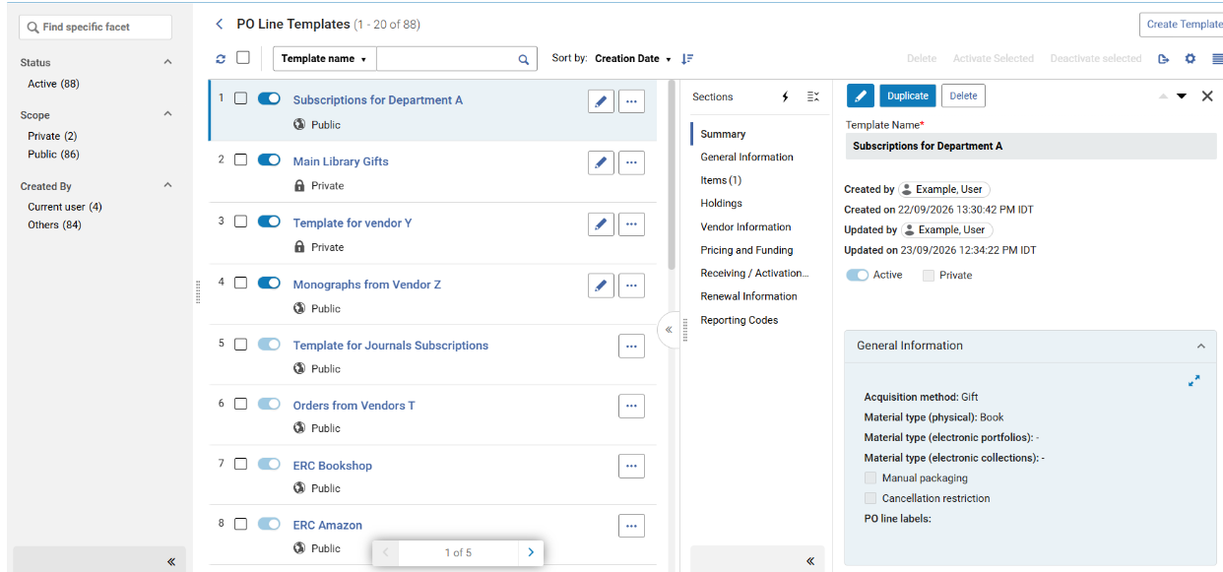
New PO Line Templates Management Page (continued)
Select Acquisitions > PO Line Templates to view the management page
Screenshot of the new PO Line Templates Management Page
Acquisitions
Notes:
[Speaker: Jen]
[Audience Tags: Acquisitions]
With the new management page users can:
* View templates values: View the field values in each template, and edit them as needed.
* Update a private template to be public.
* Update a template name.
* Create templates from scratch, from an existing PO line, or by duplicating another template.
* Activate/Deactivate: Deactivate a template, while it is being worked on. Deactivated templates will not appear when creating PO lines.
Template creation has Flexible role definitions that can be adjusted by Clarivate as needed to limit certain roles from having access to the management page, if desired.
A number of new fields have been added to the template, expected receipt date or days after ordering, claiming grace period, subscription interval, to name a few. See the full list of fields in PO Line Template Sections and Fields.

Slide 19
Electronic Resources Updates
Portfolio History Tab
  The history tab will now display changes to bib record linking, ex: when a portfolio has a new MMS ID.
Autoholdings
  Wiley and Ovid autoholdings e-Collections have been enhanced to improve portfolio matching. In addition to using ISSN and ISBN, the matching process takes unique identifiers into account.
Coverage Statements
  When there are overlapping coverage statements, they will now display as one unified coverage statement. Previously, each statement would display separately.
E-inventory Subject Area
  Two fields were removed from Alma Analytics: Managed by Provider and Provider Name.
Electronic Resources Management
Notes:
[Speaker: Marisa]
[Audience Tags: Electronic Resources Management]
Electronic Resources Management
Hello everyone! Here are four Electronic Resources Updates that may excite you or have you thinking “it’s about time!”.
The electronic portfolio history tab will now contain bib record linking changes. For example, when a portfolio gets a new MMS ID this information will now be recorded in the electronic portfolio’s history tab.
There are two updates for the automatic upload of electronic holdings aka Autoholdings. Wiley and Ovid autoholdings e-Collections will now be matched by unique identifier, in addition to using the ISSN and ISBN. Including the unique identifier in the matching process should cut down on portfolio load errors, duplication, and mismatching.
This next update concerns coverage statements. Sometimes electronic portfolios will contain multiple coverage statements that overlap in coverage. Instead of displaying all coverage statements like it was done previously, you will now see one unified coverage statement.
Finally, the last update is to the E-inventory subject area in Alma Analytics. Two fields for Electronic Collections have been removed. They are: Managed by Provider and Provider Name.
This concludes the ERM updates for Alma.

Slide 20
Guided Tours in Alma
Guided Tours can provide step-by-step guidance directly within relevant workflows
Production only; not available in Sandboxes
IZ must activate Digital Adoption which allows Ex Libris Clarivate to collect anonymized data to identify usage trends and provide optimized user experiences
  User must accept functional cookies in the browser
Purple Guided Tours icon can appear on an individual menu element and at the bottom of the page in Alma
Everyone
Configuration
Notes:
[Speaker: Jessica]
[Audience Tags: Everyone, Configuration]
New in November: Alma can now offer contextual Guided Tours that provide step-by-step guidance to staff directly within relevant workflows. These new Guided Tours are only available if your library has activated Digital Adoption in your IZ, and if the user accepts functional cookies in their browser. Digital Adoption refers to the Pendo tool that was introduced last year that allows Alma to collect anonymized usage trends to provide users with optimized user experiences. The purple Guided Tours icon can appear on an individual menu element and at the bottom of a screen in Alma as the slide on the next slide shows.

Slide 21
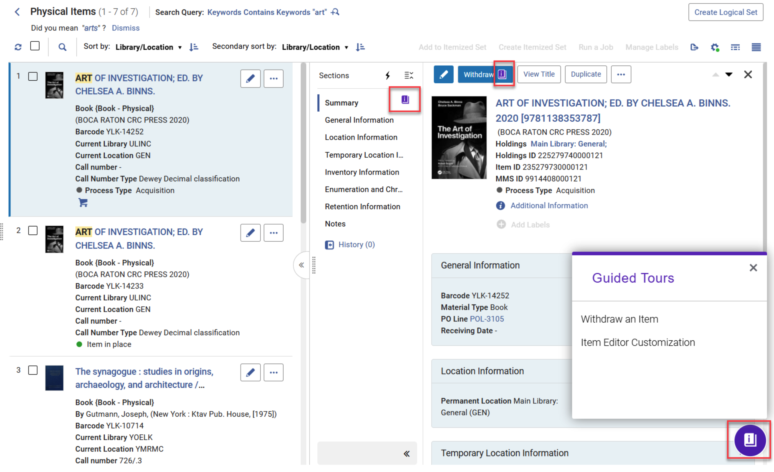


Guide Tours Icon in Alma
Everyone
Configuration
Notes:
[Speaker: Jessica]
[Audience Tags: Everyone, Configuration]
Here on the left we see two close-up images of the Guided Tours Icons.
And on the right we see a screenshot of the Physical Items search results screen in Alma. The Guided Tours icon appears as a lowercase “i” on a book and may show on an individual action or menu item, or in the lower righthand corner showing all available Tours on this page.

Slide 22
Update to Primo Search Result Limits with September 6 Release
Signed-in users to Primo can access all search results.
Guest users—users who have not signed in to Primo with a user record in your Alma IZ—can access the first 500 results in the list.
  Guest users may run a new search if they reach the limit or log in
  Optional workaround for Guest users to see more than 500 results by enabling reCAPTCHA in Primo Configuration
Ex Libris documentation on Search Limitations details the user experience
No longer possible to create a deep link URL directly to a specific page in a set of search results in Primo; all will redirect to page 1.
Primo / Discovery
Notes:
[Speaker: Jessica]
[Audience Tags: Primo/Discovery]
This slide is a reminder of a change that we talked about at the August webinar and that was emailed out to I-Share Liaisons and the CARLI Primo Interest Group list on September18:
With the September 2026 software update installed on Sunday, Sept. 6, Ex Libris has adjusted the search results limits in Primo. The Ex Libris documentation on Search Limitations has details and a helpful flow chart describing the user experience.
Signed-in users to Primo can now access all search results. (Previously, signed-in users were limited to the first 2,000 results.)
Guest users—those users who have not signed in to Primo with an account tied to a user record in your Alma IZ—can access the first 500 results in the search results list.
Guest users always have the option of running a new search or refining their search once they reach the 500-record limit.
When the Guest user attempts to view more than 500 results, they will be prompted to log in to see all results; if they do not or cannot log in, then behavior will vary based on your institution’s Primo Configuration.
There is now an optional workaround for Guest users to see more than 500 results. Institutions may choose to enable reCAPTCHA in their Primo Configuration to allow Guests to verify themselves without logging in.
This new option requires registering your institution with Google’s reCAPTCHA service, obtaining site keys for your institution, and inputting those keys into Primo Configuration in your Alma IZ.
Enabling reCAPTCHA also adds the verification check to the “Export to Email” action and to the Feedback tool in Primo.
In addition to these changes in search results behavior, when any user (Signed-in or Guest) arrives in Primo to search results generated from a “deep link”—that is, a URL that is coded to send a user directly to a targeted page of a search—the system now automatically redirects to page 1 of the results. Therefore, it is no longer possible to link directly to a specific page number within a set of search results in Primo. You can still use deep links to link to search results starting on page 1, and you can still link directly to individual records using Permalinks as before.

Slide 23
Clarivate-Managed CAPTCHA in Primo
Clarivate is implementing an additional, centrally managed CAPTCHA protection layer in Primo against malicious or automated attacks.
It will only be enabled by Clarivate if/when needed.
When activated, users may be asked to verify that they are human with a CAPTCHA pop-up.
Once verified, users can continue their session normally for 30 minutes.
This protection is separate from and unrelated to the optional institution-managed CAPTCHA option for Guest users to view more than 500 results in Primo.
Primo / Discovery
Notes:
[Speaker: Jessica]
[Audience Tags: Primo/Discovery]
Clarivate is implementing an additional, centrally managed CAPTCHA protection layer in Primo against malicious or automated attacks. This is to help keep Primo up and stable for regular users. There is no impact during normal operation. The protection is disabled by default and only activated by Clarivate when needed.
When this is activated by Clarivate staff, Primo users may be asked to verify that they are human before continuing with a CAPTCHA pop-up window. Once verified as human, users can continue their session normally for 30 minutes.
This protection is separate from and unrelated to the optional institution-managed CAPTCHA option for Guest users to view more than 500 results in Primo.

Slide 24
Primo search enhancements
Primo Research Assistant – now with Local Records!
The Research Assistant now includes local records for both the answer generation and supporting context.
The Research Assistant was enhanced to support local records for all inventory types regardless of metadata standards
This enhancement is off by default. For information about enabling it and configure it, see Including Local Records in Primo Research Assistant.
Support for Wildcards in Phrase Searches
The CDI now supports the equals exact phrase operator, aligning CDI behavior with local resources Primo VE searches.
Wildcard support in CDI is already available with the contains exact phrase operator.
The CDI portion of this enhancement will become available as part of the monthly CDI release cycle. CDI updates are typically released on the first Wednesday of each month.
Primo / Discovery
Notes:
[Speaker: Annie]
[Audience Tags: Primo/Discovery]

Slide 25
CARLI Primo NDE Updates
Next “Primo VE NDE UI: Share, Learn, and Ask” session will be Tuesday, Dec. 1, 2026 at 2pm
  Notes from previous sessions are posted in Basecamp
To join the Basecamp for all CARLI libraries implementing NDE UI, send an email to support@carli.illinois.edu with name and email
CARLI’s Primo VE NDE UI for I-Share webpage
  Not fixed in November: Requests list of the “All Institutions” view of the user’s library account still displaying twice
  Updated Mixpanel information
  Links to CARLI and I-Share libraries that have gone live on NDE
  Links to documentation and information
Primo / Discovery
Notes:
[Speaker: Jessica]
[Audience Tags: Primo/Discovery]
Finally, I want to share Primo NDE-related updates and remind you of resources for I-Share libraries.
ExLibris Clarivate is continuing to fix, develop, and add features to Primo NDE. If you look at the Primo Release Notes for November 2026, they are about 30-35% Primo VE or “Original UI” as they are now calling it, and about 65-70% NDE-only features. This is not a surprise as we have just over a year left until NDE becomes the only supported version of Primo in January 2028.
The Next Share, Learn, and Ask even hosted by your CARLI Discovery Primo Committee will be on Dec. 1. Connection information was sent to the CARLI email lists and is posted in the CARLI Basecamp, or you can email CARLI Support if you need it. These sessions are not recorded because they are informal discussions, but notes are posted in Basecamp.
Let us know at CARLI Support if you need access to the Basecamp or if someone at your library is interested in joining us there!
CARLI’s Primo NDE webpage has been updated recently.
Of note is that the issue where Requests in the “All Institutions” view of the user’s library account is still displaying each request twice, once with a Cancel button and once without. CARLI had been told that this would be fixed in the November release, but this does not appear to have happened. We are following up with Ex Libris Support to find out their new target date.
We’ve had some questions come in about Mixpanel, the new analytics tool for Primo NDE, so we’ve added more information about Mixpanel accounts
We’ve added links to the bottom of the page for I-Share and CARLI libraries that have gone live on NDE already so you can find them quickly
And as before, there are lots of links to documentation and other resources that you may find helpful

Slide 26
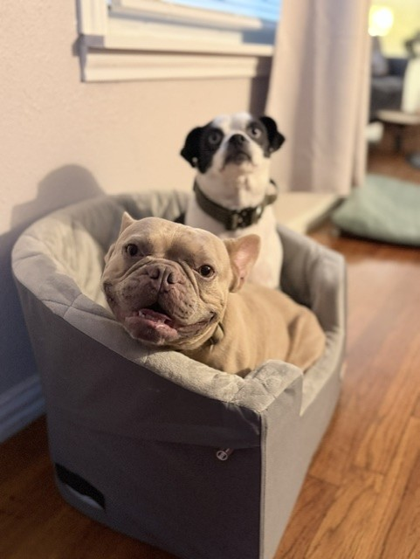
Questions?
support@carli.Illinois.edu

